Slide 1
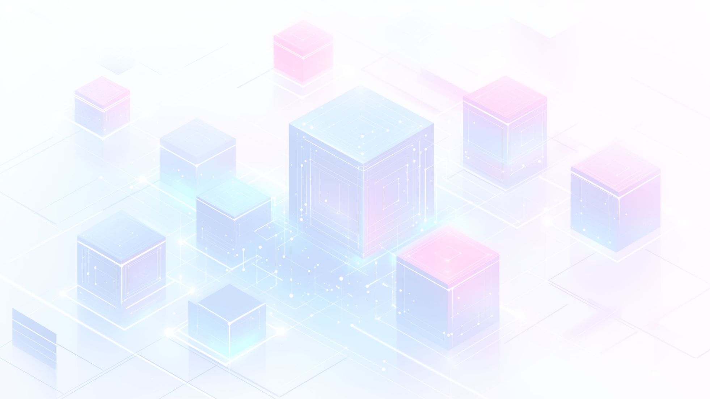

MERN Stack Development Overview
The MERN stack is a powerful web development framework that integrates four key technologies: MongoDB, Express.js, React, and Node.js. Together, these components enable developers to build dynamic and robust web applications. This presentation explores each part of the stack, highlighting their individual roles and how they collaborate to enhance the development process.

Slide 2
Self Introduction
Hello, my name is Rahul Kamat, and I’m based in Ahmedabad.
I have completed my Bachelor of Computer Applications (BCA) and I am currently pursuing MERN Stack Development training at TOPS Technologies.
I am a passionate and detail-oriented MERN Stack Developer with a strong foundation in both frontend and backend technologies including React.js, Node.js, Express.js, MongoDB, HTML, CSS, and Bootstrap. I have hands-on experience building responsive, user-friendly web applications, and I’m comfortable working with version control tools like Git and deploying applications through platforms like Vercel.
📂 Projects:
🛒 E-commerce Website – User-focused, responsive design
🤖 AI Chatbot – Interactive chat system with smart responses
🔥 IoT-based Fire Alarm System – Real-time sensor alerts and notifications
🌱I am constantly working to sharpen my skills and stay updated with the latest web technologies, with a strong focus on writing clean, scalable code and delivering quality solutions.

Slide 3

Understanding the MERN Stack
Definition
Components
Popularity
MERN is a full-stack JavaScript framework for web applications.
Includes MongoDB, Express.js, React, and Node.js.
Widely adopted for its flexibility and speed.

Slide 4
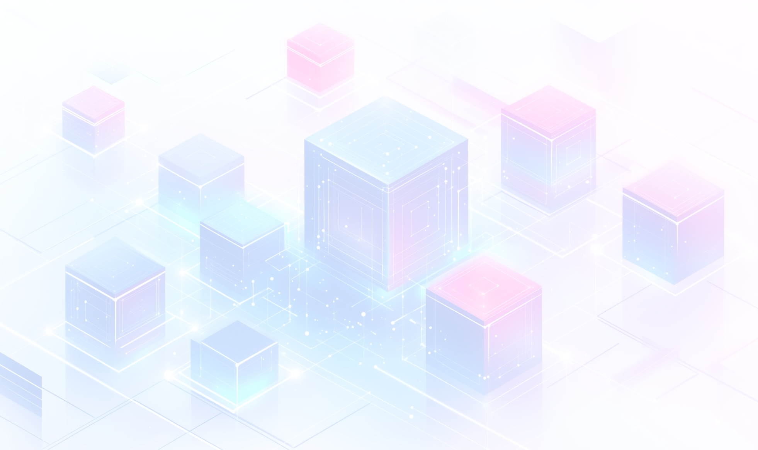
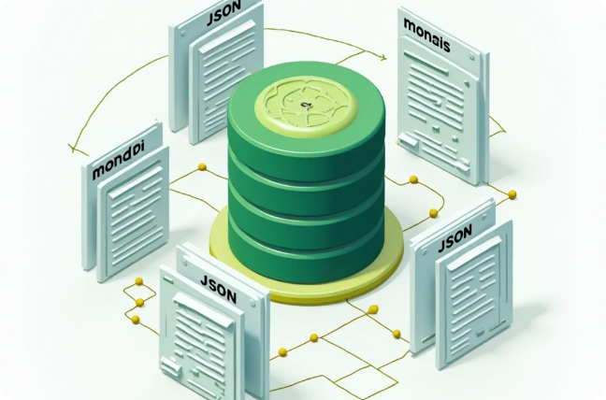
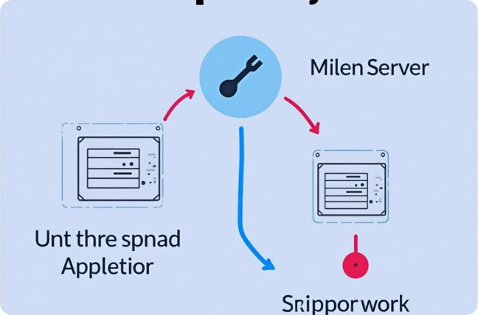
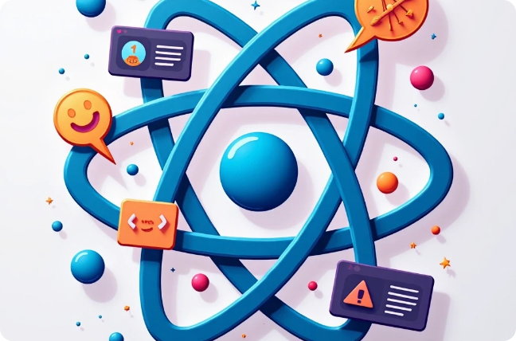
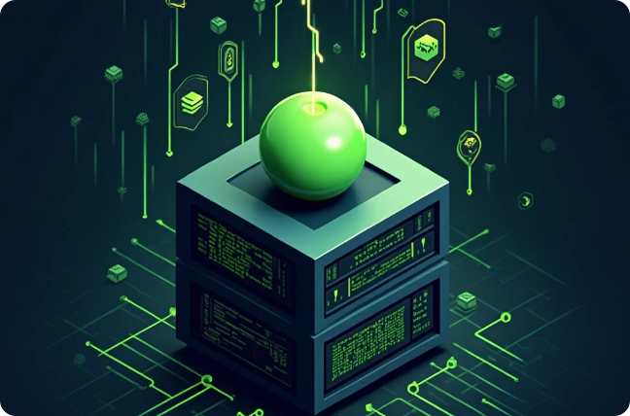
MERN Stack Components
MongoDB
Express.js
Document-oriented NoSQL database
Web application framework for Node.js
React
Node.js
JavaScript library for building UIs
JavaScript runtime for server-side coding

Slide 5
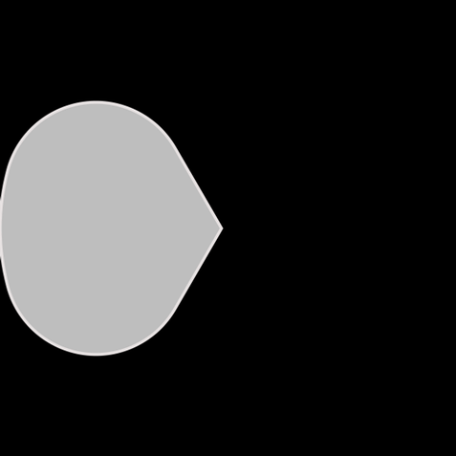


MongoDB Overview
Scalability
It offers horizontal scalability through sharding, distributing data across multiple servers.
2
Document-Oriented Database
1
MongoDB is a NoSQL database that stores data in flexible, JSON-like documents.
Rich Query Language
3
MongoDB supports a powerful query language for complex queries and data manipulation.

Slide 6
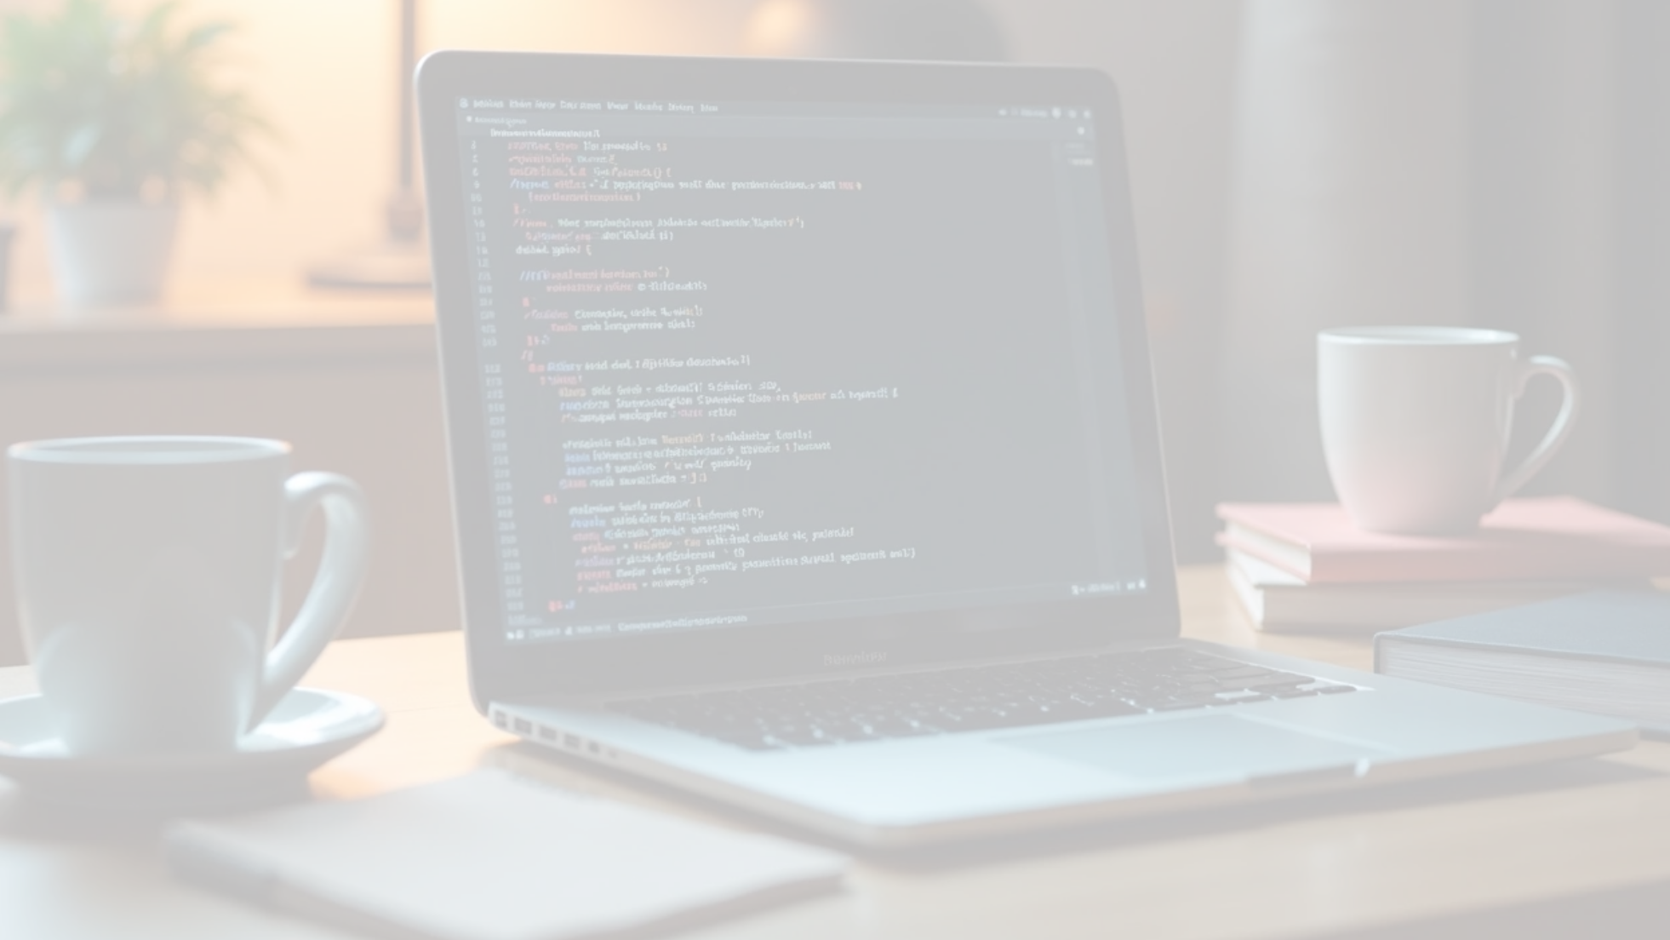

Express.js Overview
1
Web Application Framework
2
Middleware Support
3
Routing
It allows developers to use middleware to handle requests, responses, and various functionalities, thus promoting modular code design.
Express provides a simple routing mechanism for handling different HTTP methods and URLs, making it easy to define application routes.
Express.js is a minimal and flexible Node.js web application framework that provides a robust set of features for building web and mobile applications.

Slide 7
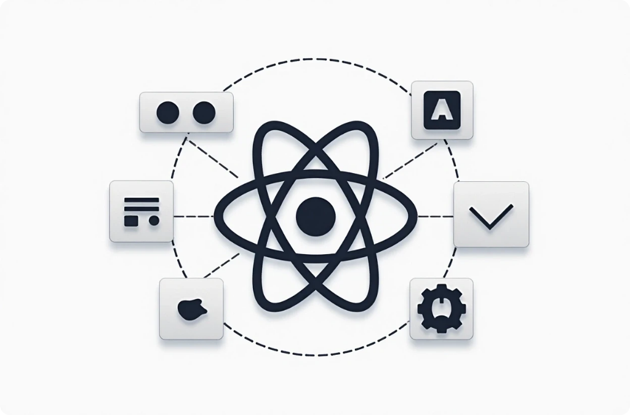


React Overview
Frontend Library
Component-Based Architecture
Virtual DOM
React is a JavaScript library for building user interfaces, particularly single-page applications where data changes dynamically without refreshing the page.
React uses a Virtual DOM to optimize rendering performance, ensuring that only changed components are updated in the browser.
It promotes building reusable UI components, enhancing code maintainability and organization.

Slide 8

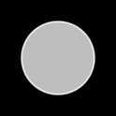



Node.js Overview
Node.js is a powerful tool for developers, enabling JavaScript to be used on the server-side. Its event-driven architecture facilitates efficient handling of numerous connections, while npm provides access to a wide array of libraries that enhance development speed.
2
Event-Driven Architecture
Efficiently handle multiple connections with a non-blocking I/O model.
JavaScript Runtime
Run JavaScript on the server-side for full-stack development.
1
Package Management
Access thousands of libraries through npm for rapid development.
3

Slide 9


Benefits of Using MERN Stack
Full-Stack JavaScript
Rapid Development
Strong Community Support
A unified language across the stack simplifies development and enhances collaboration.
Powerful tools allow faster prototyping and development cycles.
Large community and extensive documentation make resource access easier.

Slide 10
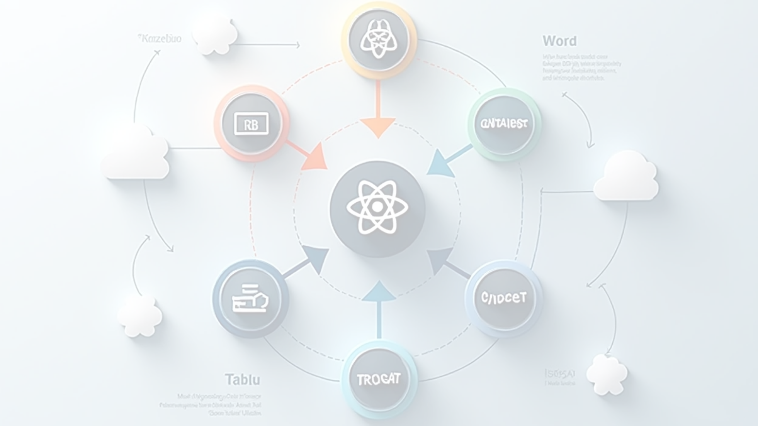

Use Cases and Applications of MERN Stack
Single Page Applications (SPAs)
Real-Time Applications
E-commerce Platforms
Applications like chat apps and collaborative tools benefit from the stack's ability to handle real-time data updates.
The flexibility and scalability of the MERN stack make it suitable for building complex e-commerce solutions.
MERN is ideal for SPAs where a smooth and fast user experience is crucial, such as social media platforms.

Slide 11
Thank You

